Slide 1
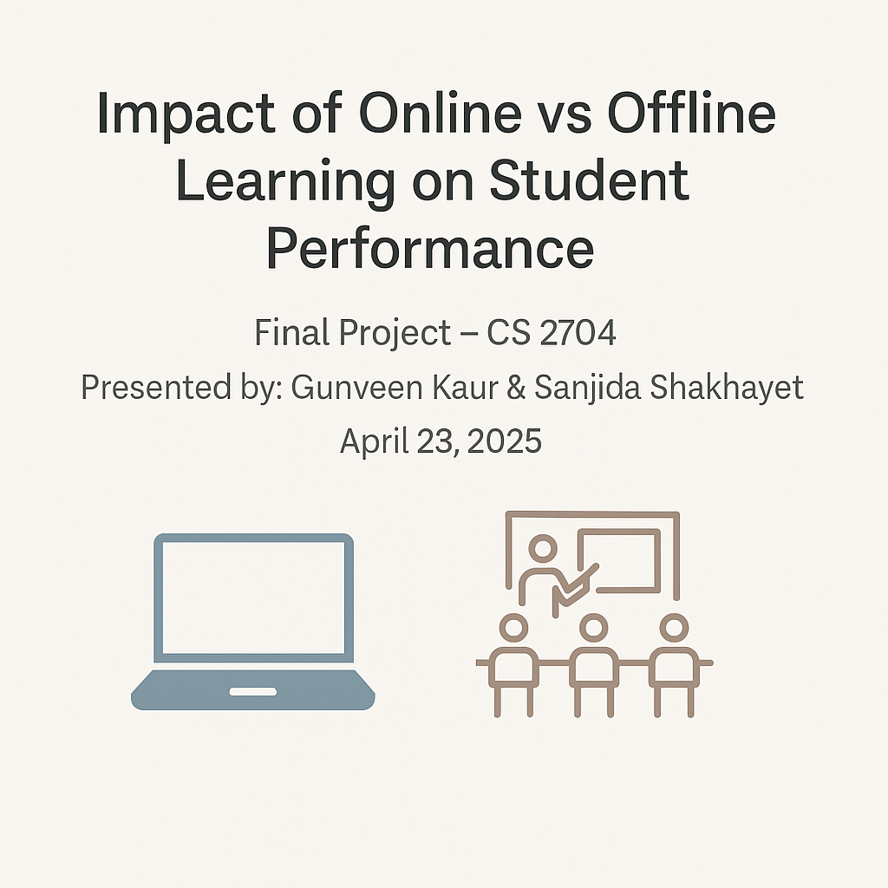

Slide 2
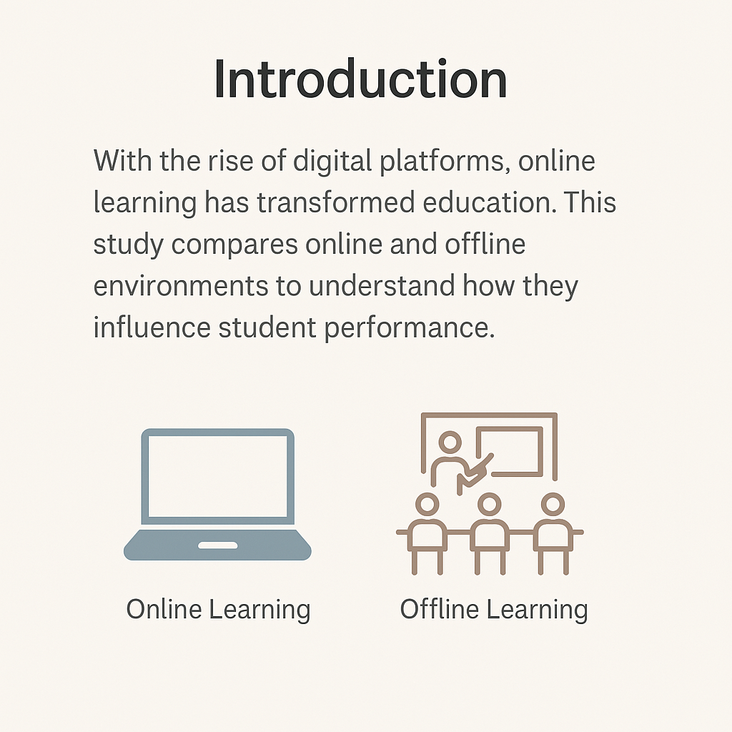

Slide 3

Hypothesis
Offline students may have better academic performance due to structured schedules and in-person interactions, while online students may benefit from flexible study conditions but struggle with engagement.

Slide 4
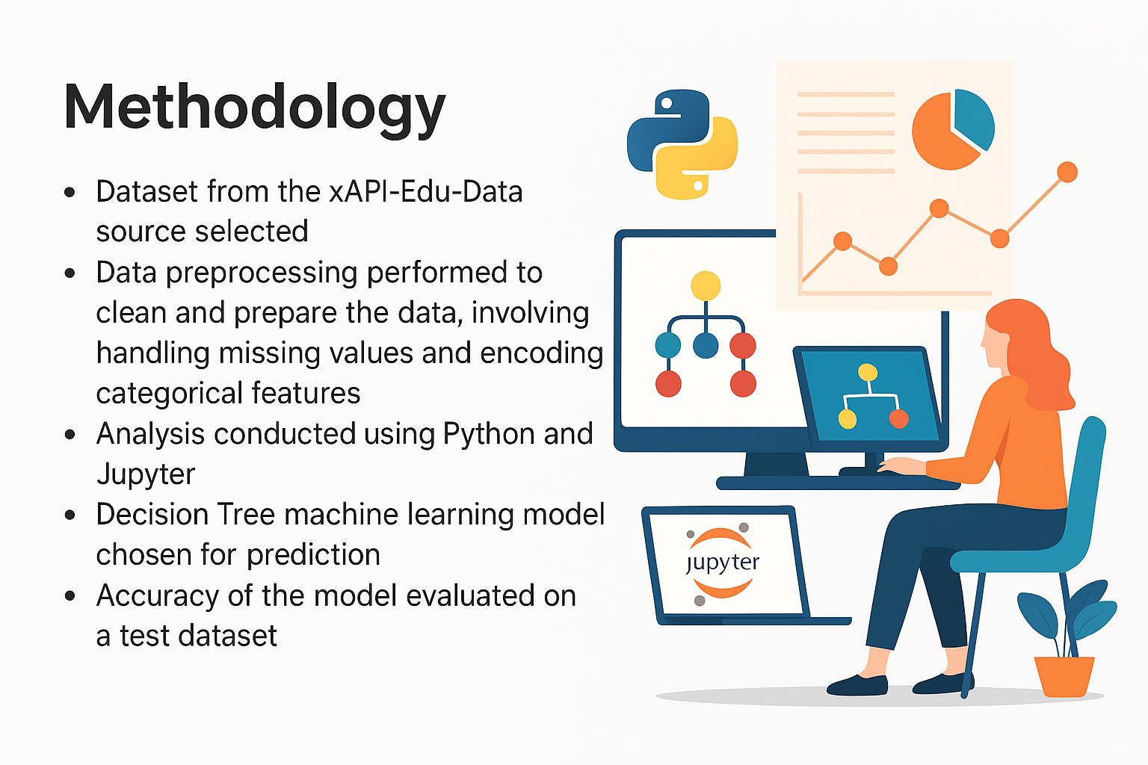

Slide 5
Final Project Report Summary
• Topic: Impact of Online vs Offline Learning on Student Performance
• Datasets: UCI (Offline), xAPI (Online)
• Tools: Python, Jupyter, pandas, seaborn, scikit-learn
• Total Students: 875 (395 Offline, 480 Online)
• Goal: Analyze and predict performance using descriptive and predictive analytics

Slide 6
Descriptive Findings
• Offline: Study time positively impacts grades, absences negatively
• Online: Engagement metrics (raised hands, discussion) positively correlate with performance
• Online grades are categorical (Low/Mid/High), Offline grades are 0–20

Slide 7
Model Performance Summary
Offline - Linear Regression:
• R² Score: -0.06 (not predictive)
• RMSE: 4.67 (on a 0–20 scale)
Online - Logistic Regression:
• Accuracy: 81.25%
• F1 Score (Low performers): 89.7%
• Model predicts online student categories well

Slide 8
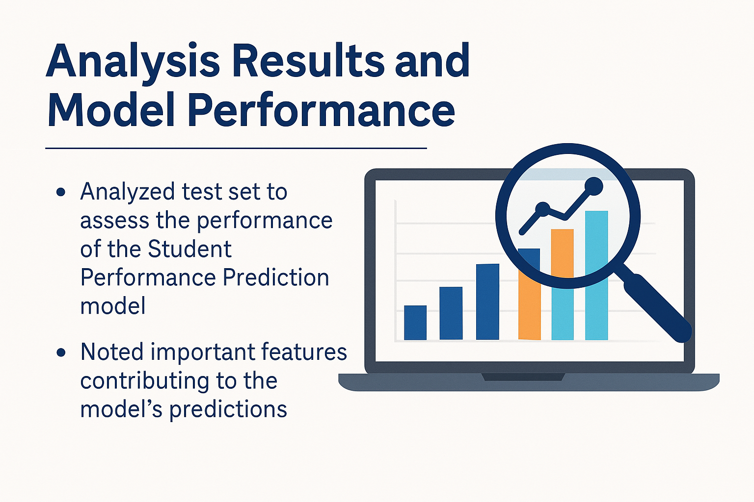

Slide 9
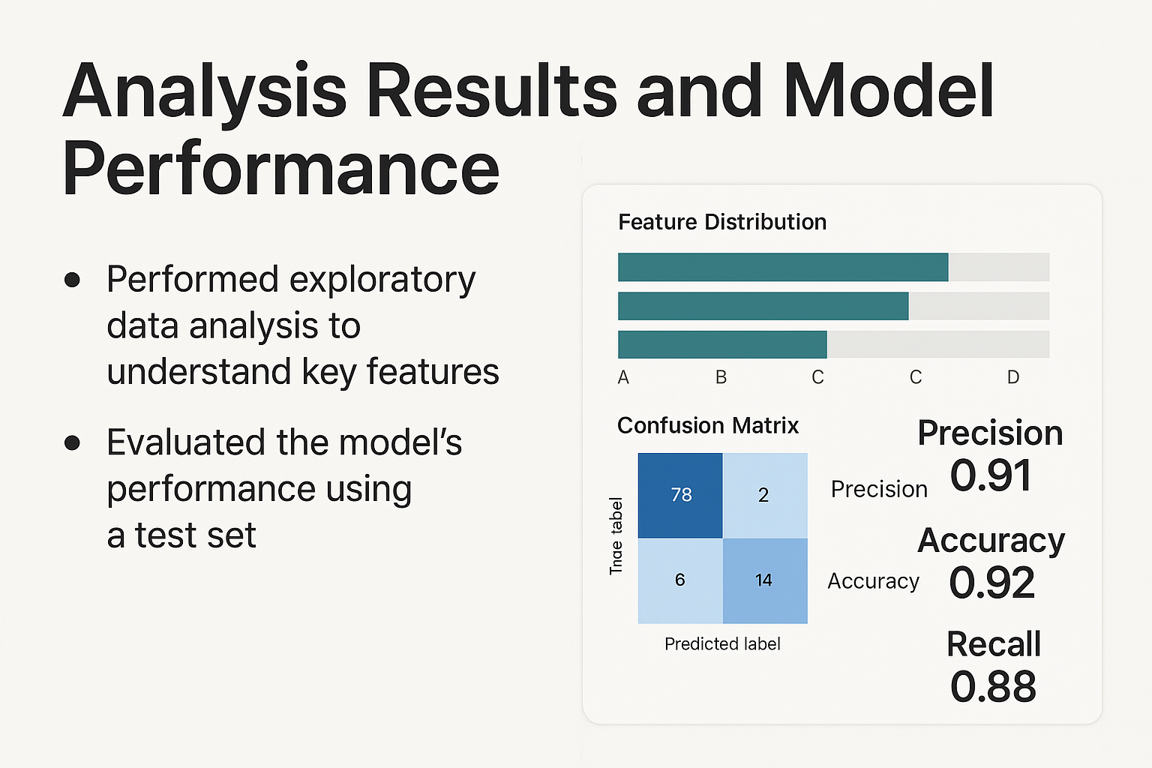

Slide 10

Conclusion
• We successfully implemented a prediction model for student academic performance.
• The model achieved an accuracy score of 68.9%.
• The most influential factors were parents’ education, class size, and study time.

Slide 11


